Slide 1
Lecture 7-9
Introduction to relational Model

Slide 2
Outline
The Relational Algebra
Select Operation
Project Operation
Union Operation
Set Difference Operation
Set intersection Operation
Cartesian Product Operation
Rename Operation
Join Operations

Slide 3
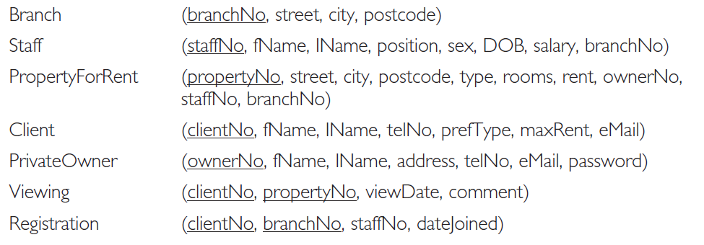
Relational schema for part of the DreamHome case study

Slide 4
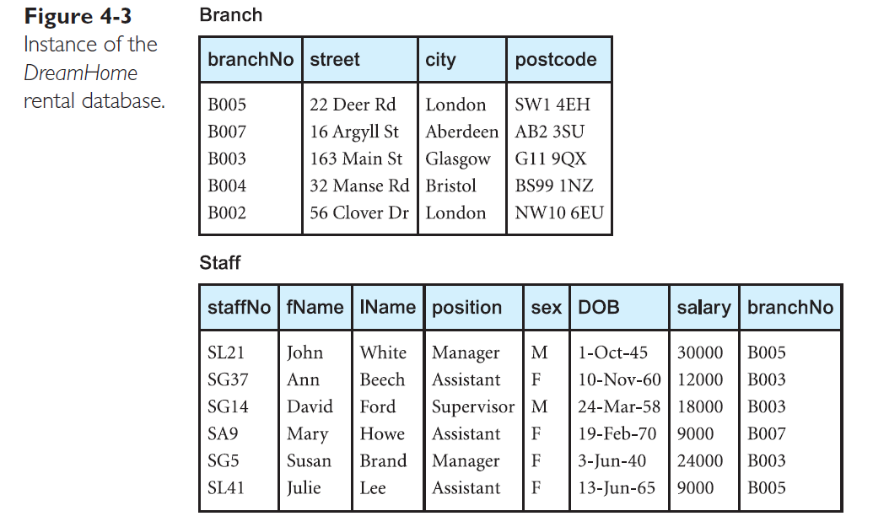

Slide 5
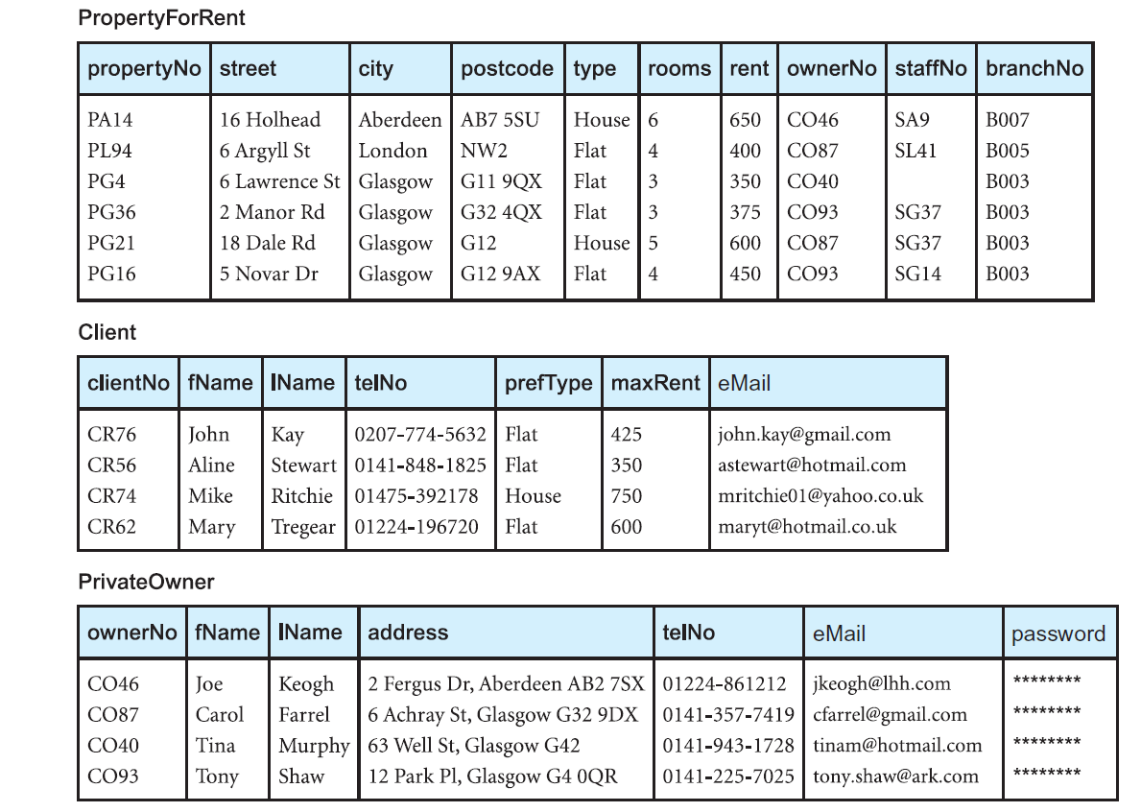
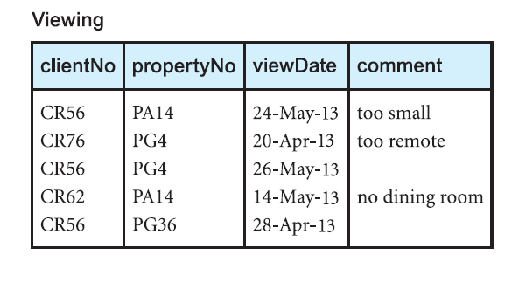
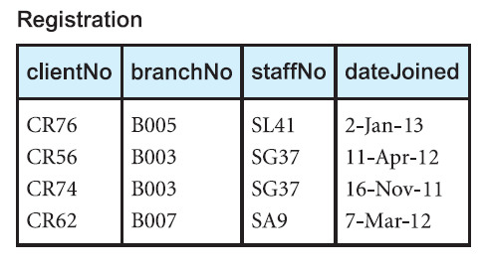

Slide 6

Example
List all cities where there is either a branch office or a property for rent.

Slide 7
Set Difference Operation
Notation: r – s
Defined as: r – s = {t | t ∈ r and t ∉ s}
Set differences must be taken between compatible relations.
1. r and s must have the same arity
2. attribute domains of r and s must be compatible

Slide 8
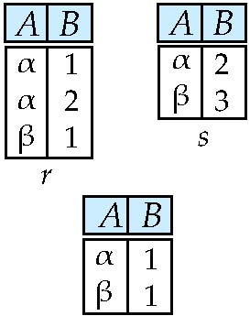
Set difference of two relations
Relations r, s:
r – s:

Slide 9

Example
List all cities where there is a branch office but no properties for rent.

Slide 10
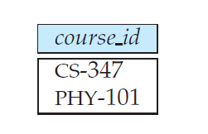

Example
Find all the courses taught in the Fall 2009 semester but not in Spring 2010 semester.

Slide 11
Set-Intersection Operation
Notation: r ∩ s
Defined as: r ∩ s = { t | t ∈ r and t ∈ s }
Assume:
1. r, s have the same arity
2. attributes of r and s are compatible
Note: r ∩ s = r – (r – s)

Slide 12
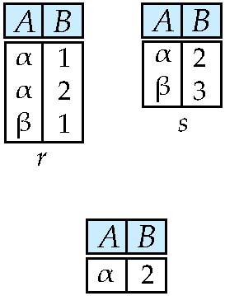
Set intersection of two relations
Relation r, s:
r ∩ s

Slide 13

Example
List all cities where there is both a branch office and property for rent.

Slide 14
Cartesian-Product Operation
Notation: r x s
Defined as: r x s = {t q | t ∈ r and q ∈ s}
Assume that attributes of r(R) and s(S) are disjoint. (That is, R ∩ S = ∅).
If attributes of r(R) and s(S) are not disjoint, then renaming must be used.

Slide 15
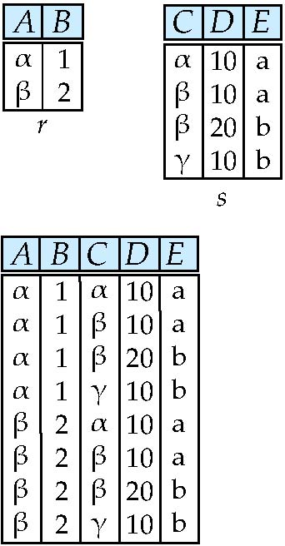
Joining two relations -- Cartesian-product
Relations r, s:
r x s:

Slide 16
Cartesian-product – naming issue
B
Relations r, s:
r.B
s.B
r x s:

Slide 17
Example
List the names and comments of all clients who have viewed a property for rent.
The names of clients are held in the Client relation and the details of viewings are held in the Viewing relation. To obtain the list of clients and the comments on properties they have viewed, we need to combine these two relations:
In its present form, this relation contains more information than we require. For example, the first tuple of this relation contains different clientNo values. To obtain the required list, we need to carry out a Selection operation on this relation to extract those tuples where Client.clientNo =Viewing.clientNo. The complete operation is thus:

Slide 18
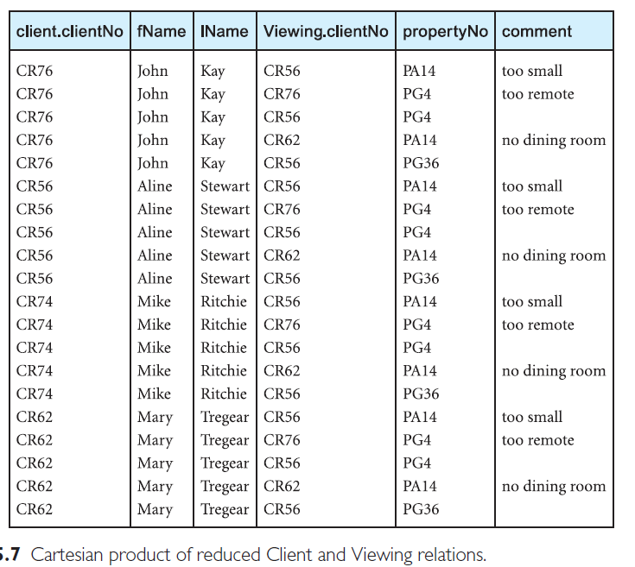
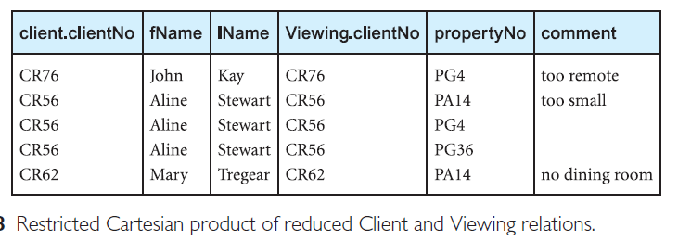

Slide 19

Example
Find the names of all instructors in the Physics department together with the course id of all courses they taught.

Slide 20
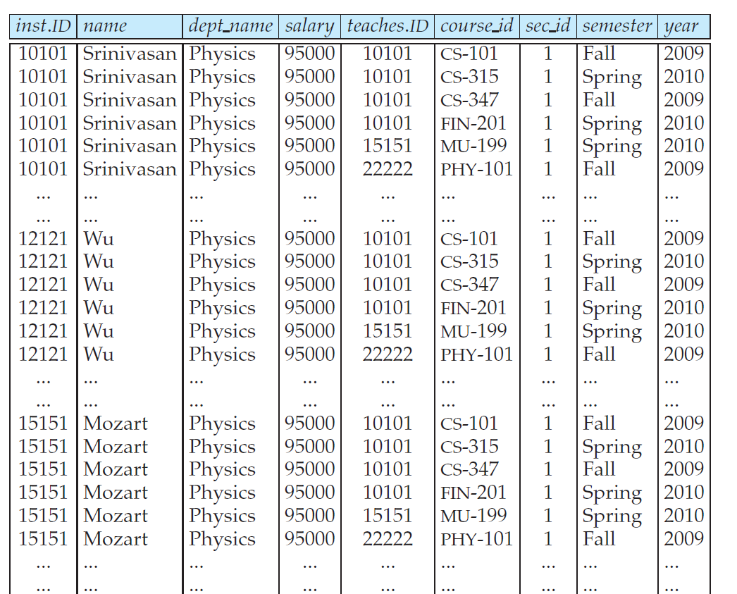
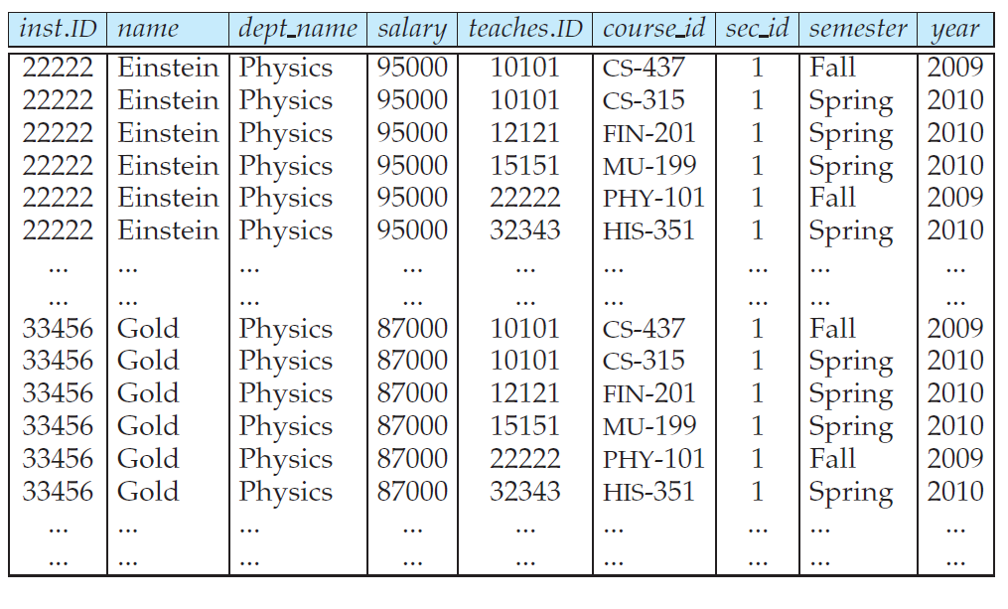

Slide 21
Rename Operation
Allows us to name, and therefore to refer to, the results of relational-algebra expressions.
Allows us to refer to a relation by more than one name.
Example: ρ _{x} (E) returns the expression E under the name X
If a relational-algebra expression E has arity n, then
returns the result of expression E under the name X, and with the attributes renamed to A₁ , A₂ , …., A_{n} .

Slide 22
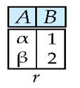
Renaming a Table
Allows us to refer to a relation, (say E) by more than one name.
ρ _{x} (E)
returns the expression E under the name X
r.A r.B s.A s.B
α
α
β
β
1
1
2
2
α
β
α
β
1
2
1
2
Relations r
r x ρ _{s} (r)

Slide 23
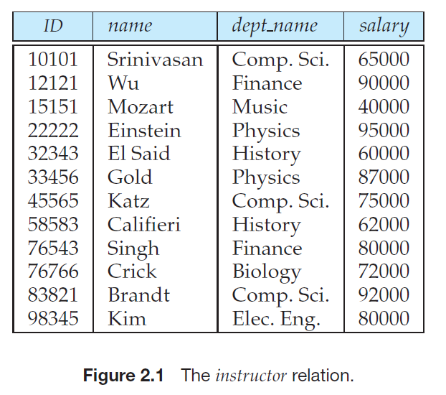
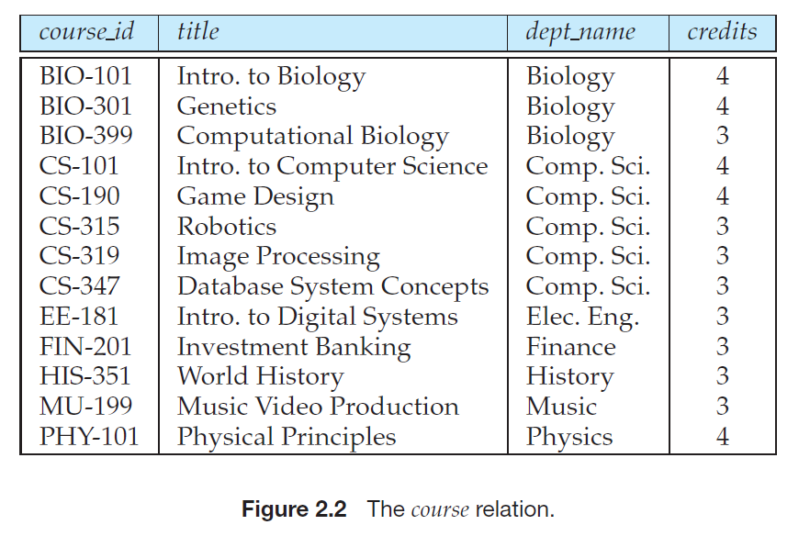
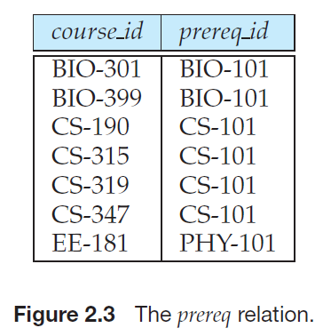
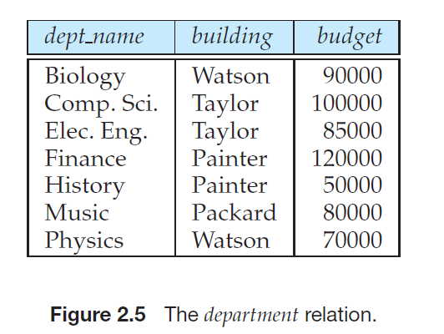

Slide 24
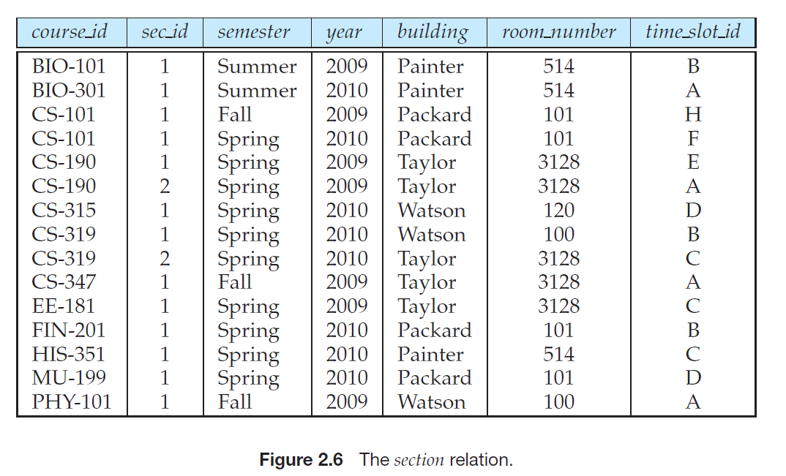
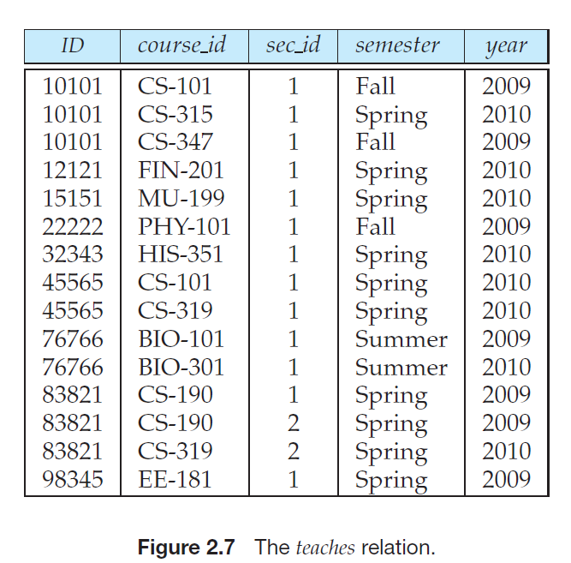

Slide 25
Example
Find the highest salary in the university.
Strategy
(1) compute first a temporary relation consisting of those salaries that are not the largest and
(2) take the set difference between the relation salary (instructor) and the temporary relation just computed, to obtain the result.

Slide 26
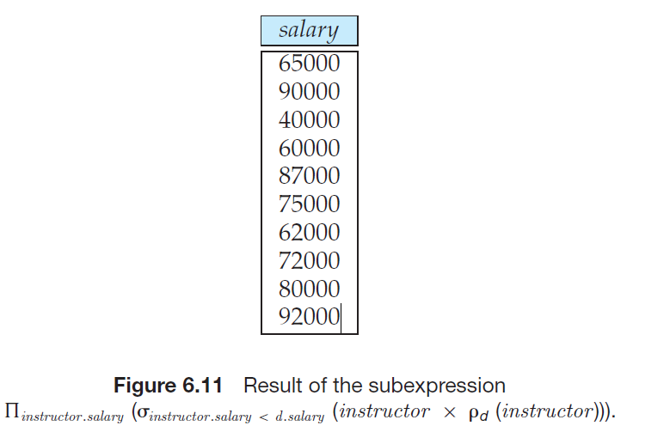
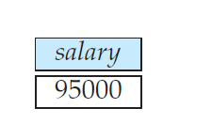
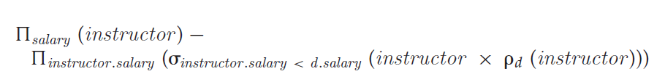

Slide 27
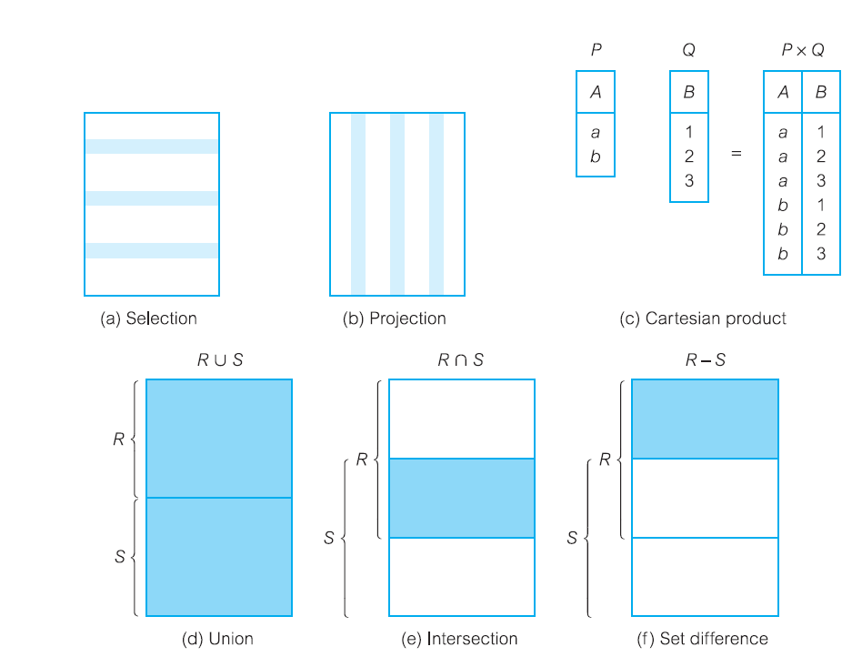
Function of the relational algebra operations.

Slide 28
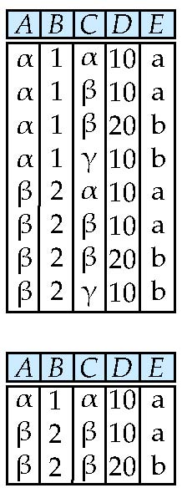
Composition of Operations
Can build expressions using multiple operations
Example: σ_{A=C} (r x s)
r x s
_{A=C} (r x s)

Slide 29
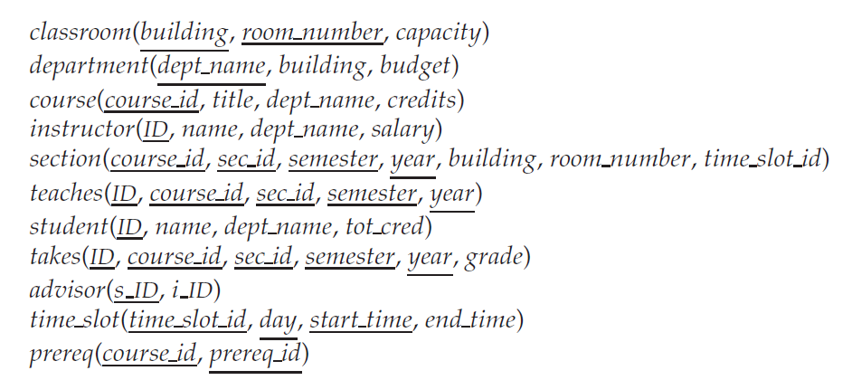
University Schema

Slide 30
Practice Exercise
show records of physics department.
Show instructor table without the dept_name attribute
find all courses taught in the Fall 2009 semester, or in the Spring 2010 semester, or in both using union operation
find all courses taught in the Fall 2009 semester, but not in the Spring 2010 semester

Slide 31
Suggested Reading
Chapter 5 of Database Systems: A Practical Approach to Design, Implementation, and Management by Thomas Conolly 6th Edition
Chapter 2 of Database System Concepts by Abraham Silberschatz

